Slide 1
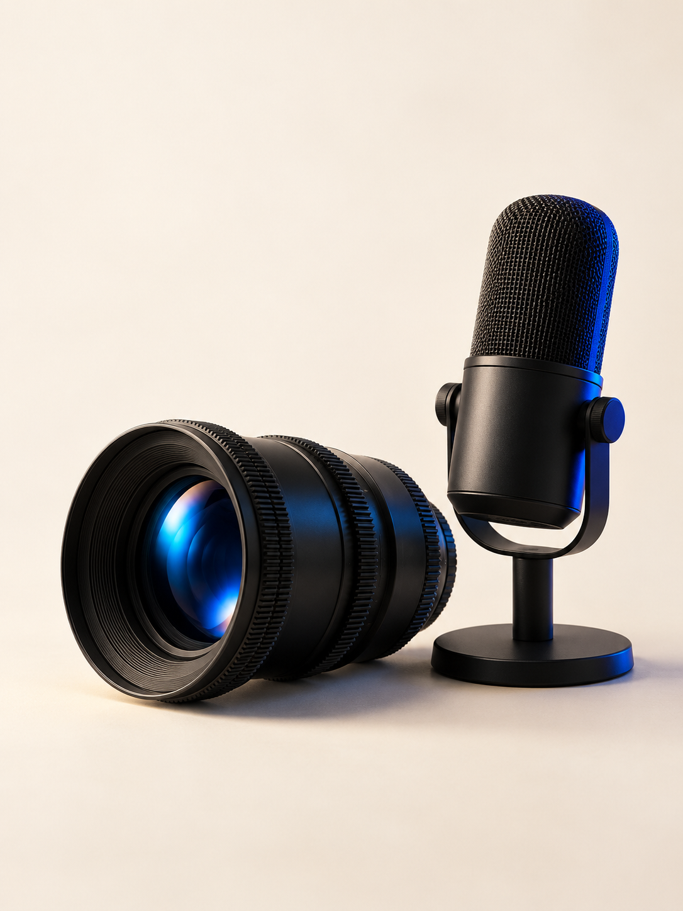
CLEVARYN
01
Content
creation
Original content for your next stage of growth.
A focused production session. Useful media across your business.
clevaryn.com/content
Notes:
CLEVARYN content creation pitch deck.
Source: https://clevaryn.com/content
Local source: /Users/austin/Documents/ChatGPT/Clevaryn/app/phase-one-config.ts, content offering.
Source lists Content Production as available with custom pricing. Formats include founder and Q&A content, short-form video, podcast production, testimonials, brand video, photography, paid creative, and content strategy.
Cover artwork is an AI-generated illustrative still life. It does not depict CLEVARYN equipment, a production session, or client work.

Slide 2

CLEVARYN
02
THE OPPORTUNITY
Your best work deserves to be seen
People want to understand who you are, how you work, and why they should choose you.
Show the people
Explain the work
Make the proof visible
Put a face and a voice behind your business.
Answer the questions customers ask before they buy.
Share real processes, products, and customer stories.
Notes:
CLEVARYN content creation pitch deck.
Source: https://clevaryn.com/content
Local source: /Users/austin/Documents/ChatGPT/Clevaryn/app/phase-one-config.ts, content offering.
Source lists Content Production as available with custom pricing. Formats include founder and Q&A content, short-form video, podcast production, testimonials, brand video, photography, paid creative, and content strategy.
Brand artwork source: /Users/austin/Documents/ChatGPT/Clevaryn/public/offering-art/attention.jpg. Illustrative brand artwork, not client evidence.

Slide 3
CLEVARYN
03
WHAT WE CREATE
Content built around your business
Video
Photography
Founder interviews and Q&A, short-form clips, brand video, and testimonials.
Original images for your website, campaigns, and social channels.
Podcasts
Strategy and creative
Podcast production with supporting clips for distribution.
Content planning and paid creative tied to your business priorities.
Notes:
CLEVARYN content creation pitch deck.
Source: https://clevaryn.com/content
Local source: /Users/austin/Documents/ChatGPT/Clevaryn/app/phase-one-config.ts, content offering.
Source lists Content Production as available with custom pricing. Formats include founder and Q&A content, short-form video, podcast production, testimonials, brand video, photography, paid creative, and content strategy.

Slide 4
CLEVARYN
04
WHERE IT WORKS
One session. More useful content
Plan the story once, then prepare the right version for each destination.
Website
Social and YouTube
Brand video, photography, and customer proof.
Short clips, Q&A, and longer conversations.
Campaigns and email
Sales conversations
Creative that supports the next customer action.
Clear answers and evidence your team can share.
Notes:
CLEVARYN content creation pitch deck.
Source: https://clevaryn.com/content
Local source: /Users/austin/Documents/ChatGPT/Clevaryn/app/phase-one-config.ts, content offering.
Source lists Content Production as available with custom pricing. Formats include founder and Q&A content, short-form video, podcast production, testimonials, brand video, photography, paid creative, and content strategy.

Slide 5
CLEVARYN
05
THE PROCESS
A clear path from brief to delivery
01
02
03
Plan
Capture
Prepare and deliver
Choose the objective, audience, stories, and formats. Agree on the scope before production.
Record the people, process, products, and customer evidence you can truthfully show.
Edit the agreed assets and prepare them for the channels in your project scope.
Notes:
CLEVARYN content creation pitch deck.
Source: https://clevaryn.com/content
Local source: /Users/austin/Documents/ChatGPT/Clevaryn/app/phase-one-config.ts, content offering.
Source lists Content Production as available with custom pricing. Formats include founder and Q&A content, short-form video, podcast production, testimonials, brand video, photography, paid creative, and content strategy.

Slide 6
CLEVARYN
06
WAYS TO WORK TOGETHER
A project that fits your priorities
We shape the engagement around the work you need.
Focused content session
A defined story and a useful set of assets for an immediate need.
Launch or campaign
Content organized around a new offer, product, or business moment.
Ongoing content
Discuss a recurring production rhythm for a consistent presence.
Engagement options are scope examples. We confirm deliverables and cadence in your proposal.
Notes:
CLEVARYN content creation pitch deck.
Source: https://clevaryn.com/content
Local source: /Users/austin/Documents/ChatGPT/Clevaryn/app/phase-one-config.ts, content offering.
Source lists Content Production as available with custom pricing. Formats include founder and Q&A content, short-form video, podcast production, testimonials, brand video, photography, paid creative, and content strategy.
Engagement options are scope examples. We confirm deliverables and cadence in your proposal.

Slide 7
CLEVARYN
07
AVAILABILITY
Let’s find the right production window
Content projects are available by inquiry.
Share your timing
Tell us your preferred dates, location, and any launch deadline.
Confirm the scope
We review formats, production needs, and the delivery schedule with you.
Reserve the work
We confirm availability and project terms before booking.
Production dates and turnaround depend on the agreed scope and schedule.
Notes:
CLEVARYN content creation pitch deck.
Source: https://clevaryn.com/content
Local source: /Users/austin/Documents/ChatGPT/Clevaryn/app/phase-one-config.ts, content offering.
Source lists Content Production as available with custom pricing. Formats include founder and Q&A content, short-form video, podcast production, testimonials, brand video, photography, paid creative, and content strategy.
Production dates and turnaround depend on the agreed scope and schedule.
No live calendar or open production dates were provided. Availability is subject to inquiry and confirmation.

Slide 8
CLEVARYN
08
SCOPE AND INVESTMENT
Clear deliverables. A tailored proposal
We define the work with you, then confirm the investment.
Production scope
Session needs, locations, formats, and the assets you want to receive.
Delivery and approvals
Milestones, review responsibilities, and the agreed delivery date.
Usage and ownership
Where the content will run and what rights your project requires.
Pricing follows the agreed scope. We do not list fixed packages or rates here.
Notes:
CLEVARYN content creation pitch deck.
Source: https://clevaryn.com/content
Local source: /Users/austin/Documents/ChatGPT/Clevaryn/app/phase-one-config.ts, content offering.
Source lists Content Production as available with custom pricing. Formats include founder and Q&A content, short-form video, podcast production, testimonials, brand video, photography, paid creative, and content strategy.
Pricing follows the agreed scope. We do not list fixed packages or rates here.
The local content offering uses pricingMode: custom. This deck does not represent a fixed price or binding package.

Slide 9
CLEVARYN
09
NEXT STEP
Your next content project starts here
Tell us about your business, the content you need, and your preferred timing.
We’ll review the brief and help define the next step.
Plan a content project
hello@clevaryn.com
clevaryn.com/contact
Notes:
CLEVARYN content creation pitch deck.
Source: https://clevaryn.com/content
Local source: /Users/austin/Documents/ChatGPT/Clevaryn/app/phase-one-config.ts, content offering.
Source lists Content Production as available with custom pricing. Formats include founder and Q&A content, short-form video, podcast production, testimonials, brand video, photography, paid creative, and content strategy.

